Slide 1
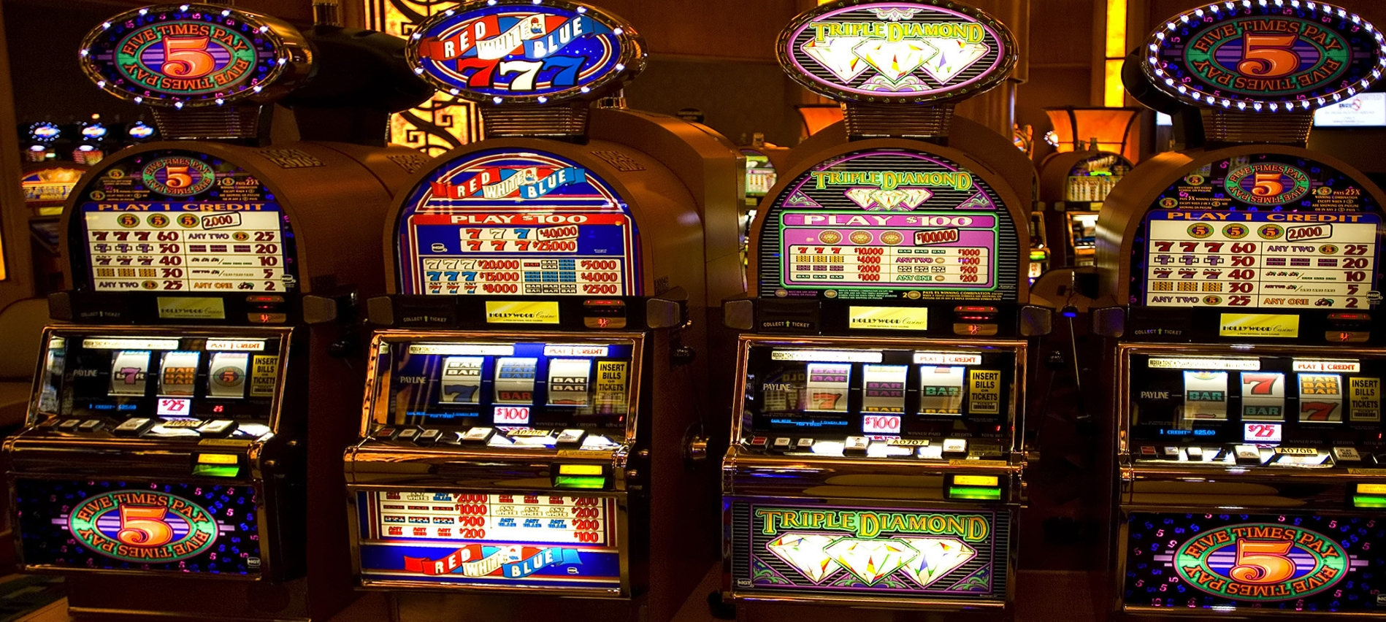

Slide 2
Multi-armed Bandit Strategies
E
X
% imp.
ε-first (A/B test)
Time
X
ε-greedy
E
Other strategies

Slide 3
ε-Greedy MAB Strategy
For each ad request
With probability ε, serve a random variant
With probability 1–ε, serve the variant with the highest estimated success rate
Observe feedback (success / no success)
Update knowledge about variants (i.e., update success rate estimates)
X
E

Slide 4
Celtra ε-Greedy MAB Strategy
For each ad request
With probability ε, serve a random variant
With probability 1–ε, serve a variant from the greedy slot
X
E
Each hour
Update knowledge about variants (i.e., success rate estimates, variant comparison results)

Slide 5
Greedy Slot Allocation
D
A
B
Variants A, B, C, D
A better than C
B better than C
C
Greedy slot allocation procedure
Sort variants by their success rate from smallest to largest
Allocate equal shares
For each variant, reallocate its share equally among the variants that are better than this variant
0.25/2 + 0.25
0.25
B
A: 0.375
0.25/2 + 0.25
0.25
A
Success rate
B: 0.375
0.25
D
D: 0.25
0.25
C
0

Slide 6

T.T.T.T.T.H.T.H.T.H.T.T.H.H.H.H.T.H.T.H
H : T = 9/20 : 11/20

Slide 7
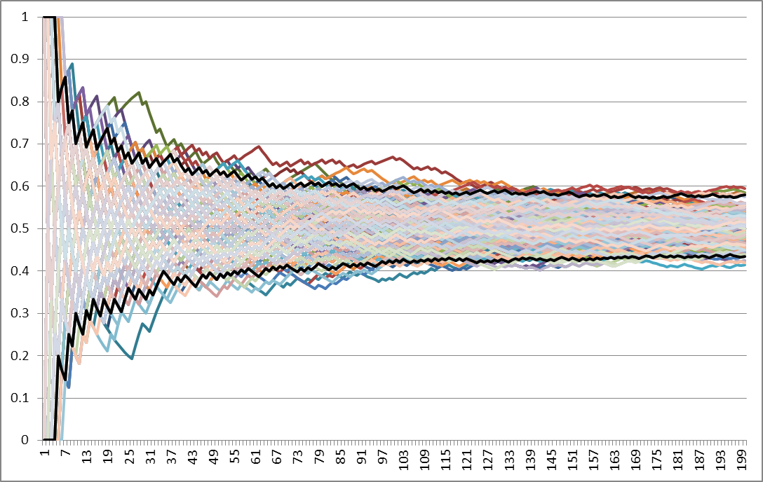
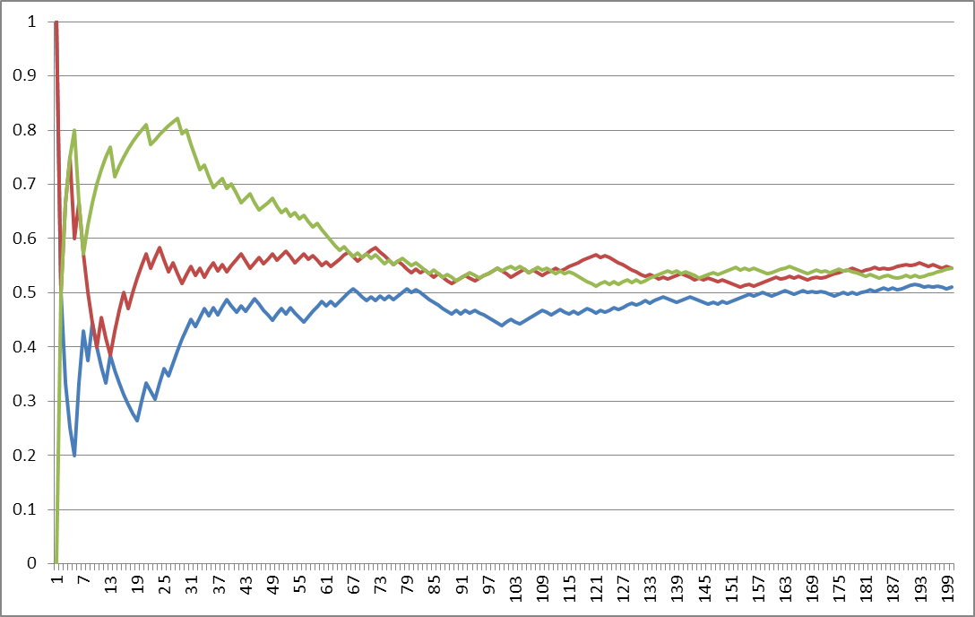
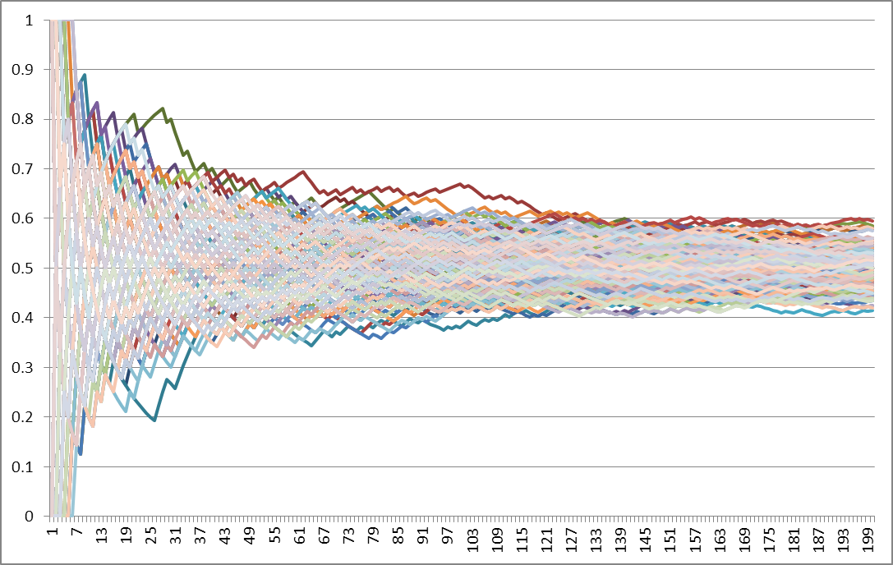
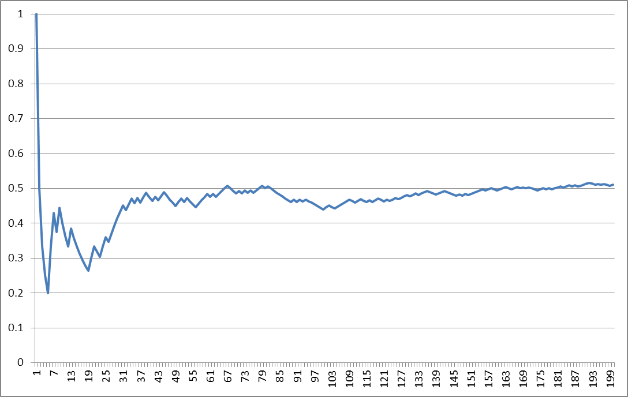
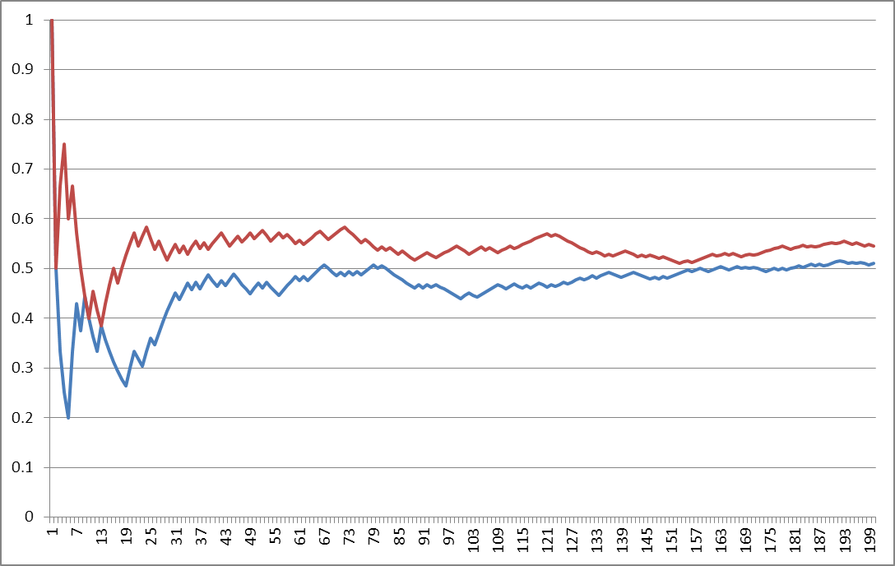

Slide 8
Variant Comparison
Multiple-comparison procedures
Marascuilo procedure (pairwise)
Tukey-Kramer procedure (pairwise)
Dunnett’s procedure (vs. control)
MCB (vs. best or worst)
Do we get a random pair swapped
in more than 5% of cases?
Correction due to multiple tests
Boneferroni correction
Sidak correction
No: The red is better than the green
Yes: The difference is not really significant

Slide 9

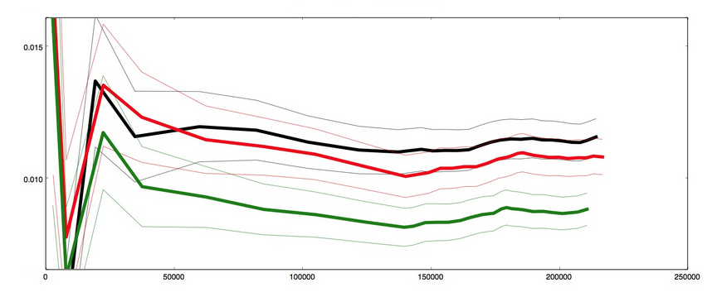


Real-life Example

